Slide 1
Kickstarter
Ramachandran Chandrasekaran

Slide 2
Analytical Problem
Can you predict the success or failure of a Kickstarter campaign given particular variables, including:
Campaign Category
Number of Backers
Length of Campaign
Dollar Goal Amount
Country (US vs. Non-US)

Slide 3

Business Purpose
Kickstarter is a crowdsourcing site where people can raise money from potential donors in order to fund their projects.
Campaigners must set a goal amount at the beginning of their campaign, and then they often give something to donors at certain levels of donations in order to incentivize more donations.
If a goal is successful, Kickstarter collects a 5% fee from the amount raised, therefore Kickstarter is highly incentivized to ensure the success of each of the projects launched on their site so that they can collect fees from those projects.

Slide 4
Dataset
The Kickstarter data was provided in class and is through Kaggle and had over 300k campaigns within it initially.
The data require some cleaning with Excel, including removing the ‘category’ which fed into a ‘main category’ due to it having over 100 options.
We also changed the countries to be US vs. Non-US due to the larger volume of countries that did not have a substantial amount of campaigns.

Slide 5
Binomial Logistic Regression
Binomial Logistic Regression tries to predict the outcome when the response variable is binary with the best possible accuracy after considering all the variables at hand.
It calculates the probability of each point in the dataset, and the point can either be 0 or 1, in our case, success or failure.
The coefficients we get after using logistic Regression tell us how much that particular variables contribute to the log odds. We use "status" as a response and see if we can predict it as a binary outcome using Logistic Regression when the predictor variables are category, backer, country, and length.

Slide 6
Linear Discriminant Analysis
Linear Discriminant Analysis (LDA) is a method used to find linear combinations of features that characterizes or separates two or more classes of objects.
Attempts to express one dependent variable as a linear combination of other measurements.
In this case, we are given a classification model where we are trying to predict the success/failure status of the Kickstarter data using the LDA model.

Slide 7
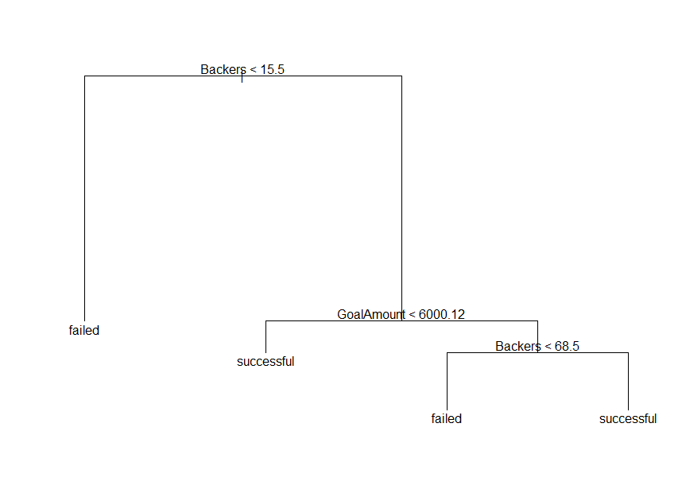
Classification Tree
Because we were working with a binomial y variable, we needed an additional classification model.
KNN was harder to interpret.
Relatively easy interpretation once the tree is pruned.

Slide 8
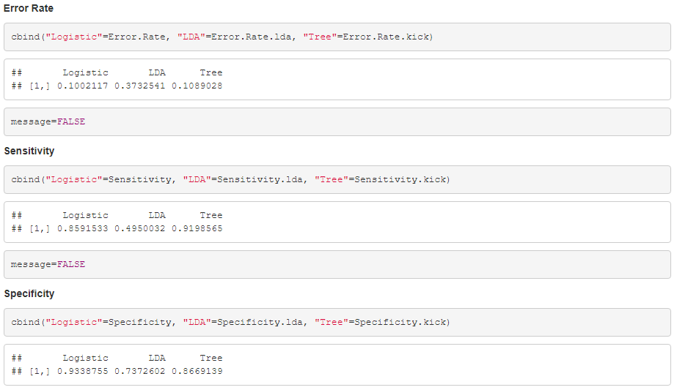
Final Thoughts
Logistic model is the best model to use, even though the classification tree was close.
Dance, Film & Video, and Technology are the best categories and increasing backers is important for success.
Modeling takes a lot of trial and error and many iterations.

